Slide 1

Designing a Three-Stage Common-Emitter Amplifier Using 2N2222 Transistors
Project by: Infinity Explorers 2 Navigation and Space Technology - Beni-Suef University Date: 12/05/2025

Slide 2
Infinity Explorers 2
Mostafa Hatem Ghonim
Mriam Mansour Bishara
Responsible for design and testing
Data Collector
Mariam Emad Kamal
Yousef Abdullah Abdelhalim
Collect and select components
PowerPoint and presentation design

Slide 3





Introduction to Amplifiers and Common-Emitter Configurations
What is an Amplifier?
An electronic circuit that increases signal power or voltage.
Common-Emitter Role
Provides high voltage and current gain using a transistor.
2N2222 Transistors
Popular NPN transistors, cost-effective, widely used in amplifiers.
Multi-Stage Amplification
Needed to achieve sufficient overall gain in applications.

Slide 4


Advantages & Disadvantages
Advantages
Disadvantages
High voltage and current amplification.
May cause signal distortion if not designed carefully.
Achieving a large overall gain through successive stages.
Higher power consumption compared to single-stage amplifiers.
Flexible design that can be modified to improve frequency response.
Complexity in design and implementation due to multiple stages.
Widely used in audio amplification and communication applications.
Need for compensation stages to manage stability and prevent oscillation.

Slide 5

Difference Between Two-Stage, Three-Stage, and Four-Stage Amplifiers
Two-Stage Amplifier
Three-Stage Amplifier
Four-Stage Amplifier
Simpler design with moderate gain, less power consumption, and relatively easier stability control. Suitable for applications requiring moderate amplification.
Provides higher voltage and current gain by adding an extra amplification stage. More complex to design and may require compensation for stability and distortion control.
Offers very high overall gain by cascading four amplification stages. This design is more complex, consumes more power, and requires careful design to prevent oscillations and distortion.
Choosing the number of stages depends on the required gain, frequency response, and application constraints.

Slide 6
Overview of the Three-Stage Amplifier Design
Stage 1: Initial Amplification
Stage 2: Intermediate Amplification
Stage 3: Output Stage
Prepares weak input signals for stronger processing.
Delivers amplified signal to the load or next system.
Boosts signal amplitude further for clarity.

Slide 7
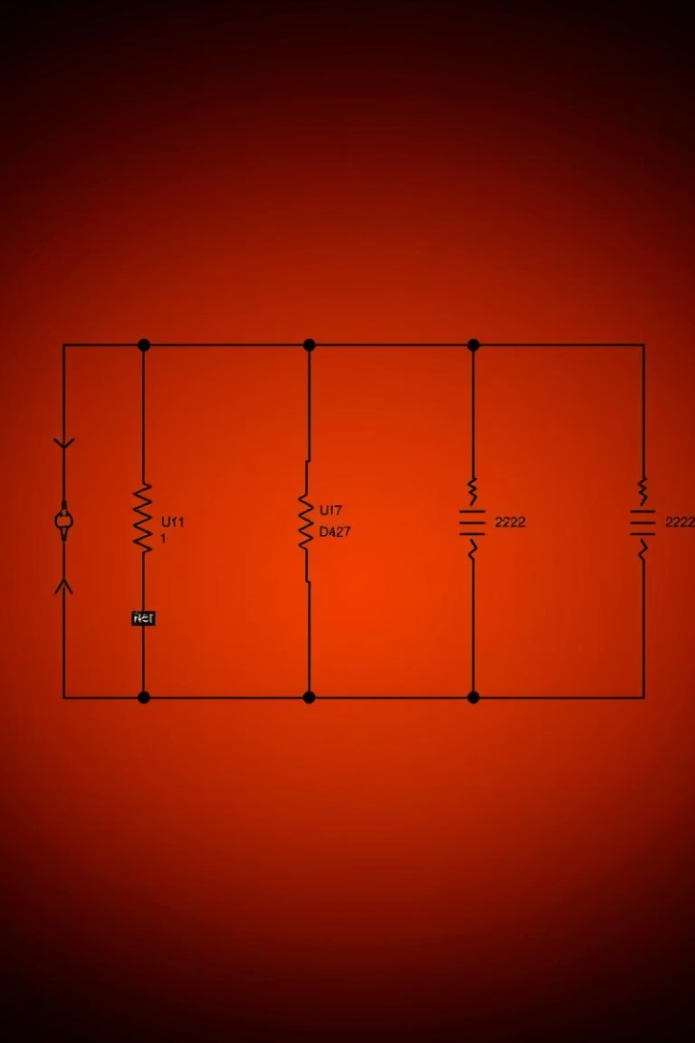



Detailed Circuit Diagram
Component Values
Operating Points
Specific resistors and capacitors chosen per stage for stability.
Defined IC and VCE for each transistor ensure amplification.
Stage Connections
Direct coupling between stages maintains signal integrity.

Slide 8

Bypass vs Coupling Capacitors in Amplifiers
Bypass Capacitors
Coupling Capacitors
Increase gain by stabilizing emitter voltage in transistor circuits.
Block DC while allowing AC signals to pass between stages.
Placed between amplifier stages
Connected in parallel with emitter resistor
Prevent DC bias interference
Provide low impedance path for AC signals
Maintain signal integrity across stages
Enhance voltage gain without affecting DC bias

Slide 9
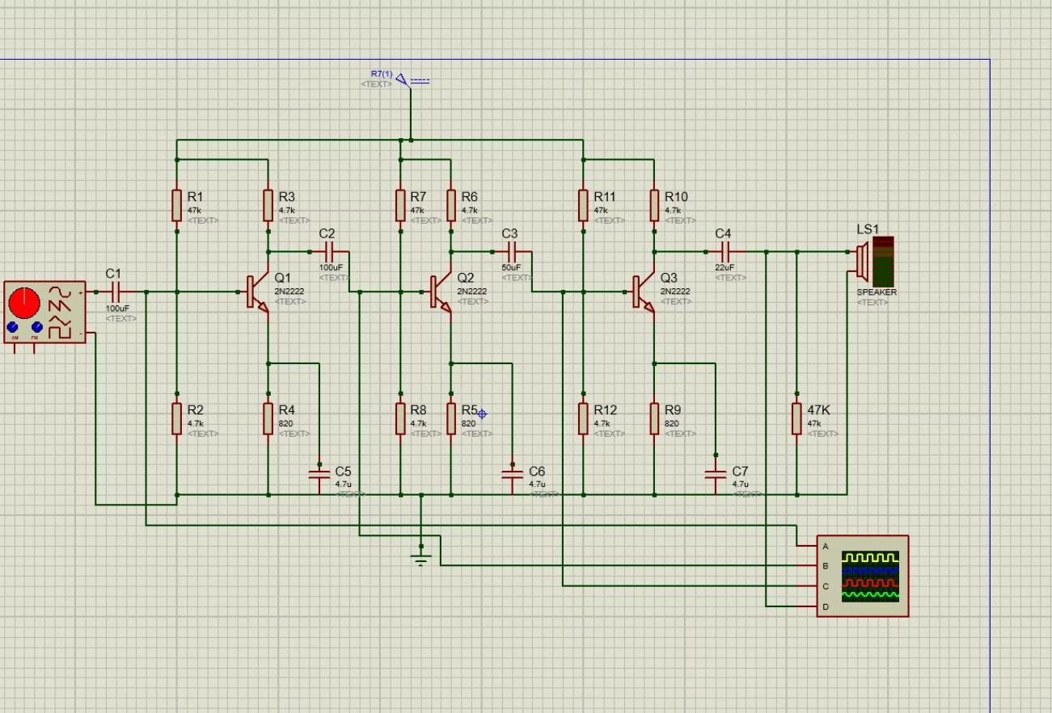
Circuit Description:
Three-Stage Common Emitter Aplifire (2N2222)

Slide 10
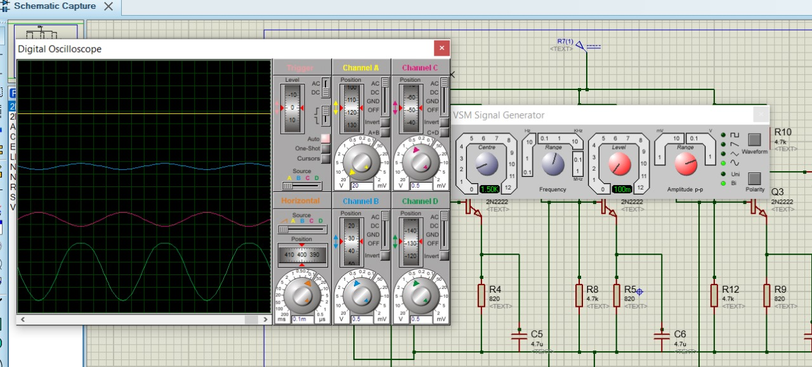

Slide 11

Voltage and Current Gain Calculations
Compare with Expected
Overall Gain
Verify measured gain matches design predictions closely.
Calculate Stage Gains
Multiply gains of all three stages to find total amplification.
Evaluate voltage gain and current gain separately per stage.

Slide 12

Practical Applications of the Three-Stage Amplifier
Audio Amplifiers
Communication Devices
Boost signals in speakers and audio devices for clarity.
Enhance weak wireless signals for better transmission.
Medical Equipment
Industrial Controls
Amplify biological signals like ECG for monitoring.
Strengthen control signals in automated processes.

Slide 13




Summary and Conclusions
Key Takeaways
Performance
Future Improvements
Design and build of a three-stage common-emitter amplifier using 2N2222.
Achieves high voltage and current gain suitable for various applications.
Consider using alternative transistors or adding more stages.

Slide 14
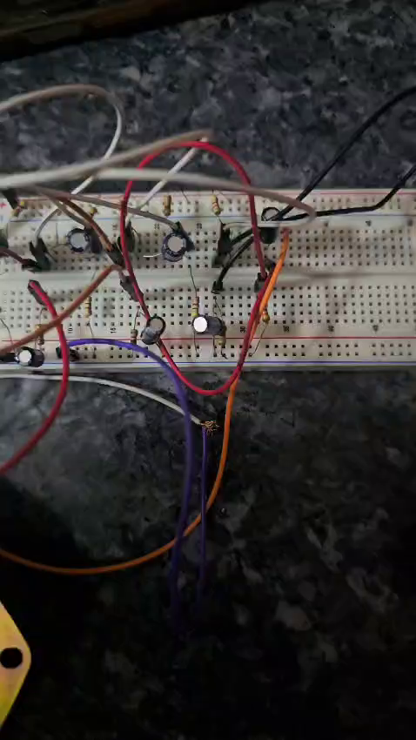
Video of the circuit in action

Slide 15
Thank You for Listening
We appreciate your attention throughout the presentation.
Please feel free to ask any questions you may have.

